Slide 1

Compiler Design
Preet Kanwal
Department of Computer Science & Engineering
Teaching Assistant : Kavya P K

Slide 2

Compiler Design
Unit 4: Live-Variable Analysis
Preet Kanwal
Department of Computer Science & Engineering

Slide 3
Compiler Design Lecture Overview
In this lecture, you will learn about -
What is Live variable analysis?
Liveness
Applications
Data flow values and equations
Live-Variable Analysis Algorithm
Examples

Slide 4

COMPILER DESIGN
Data Flow Analysis
Data-flow Analysis refers to a body of techniques that derive information about the flow of data along program execution paths.
Control flow graphs
Examples
One way to implement global common sub-expression elimination requires us to determine whether two textually identical expressions evaluate to the same value along any possible execution path of the program.
If the result of an assignment is not used along any subsequent execution path, then we can eliminate the assignment as dead code.

Slide 5
Data flow Control flow
COMPILER DESIGN
Data Flow Analysis
x = 1
print(x)
If(c > 0)
x = 4
print(x)

Slide 6
COMPILER DESIGN
Data Flow Analysis
x = 1
x = 1
print(x)
x = 1
If(c > 0)
x = 1
x = 1
x = 4
x = 4
print(x)
x {1, 4}
Э

Slide 7
COMPILER DESIGN
Data Flow Abstraction
Program can be viewed as transformation in states
Input state is associated with program point before the statement
Output state is associated with Program point after the statement execution
Program behavior-possible sequence or paths of program points

Slide 8
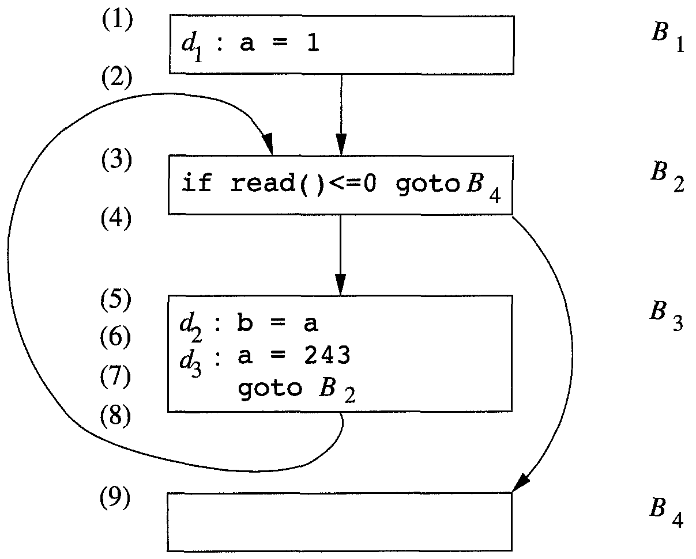
COMPILER DESIGN
Data Flow Analysis
Flow graph depicts the possible execution paths.
Within one basic block, the program point after a statement is the same as the program point before the next statement.
If there is an edge from block B1 to block B2, then the program point after the last statement of B1 may be followed immediately by the program point before the first statement of B2.
Program points

Slide 9
COMPILER DESIGN
Data Flow Analysis
Figure describes an unbounded number of execution paths.
Not entering the loop at all, the shortest complete execution path consists of the program points (1,2,3,4,9).
The next shortest path executes one iteration of the loop and consists of the points (1,2,3,4,5,6,7,8,3,4,9).
Data-flow abstraction

Slide 10
COMPILER DESIGN
Data Flow Analysis
We denote the data-flow values before and after each statement s by IN[s] and OUT[s], respectively.
IN[s] : Set of variables live before statement s
OUT[s] : Set of variables live after statement s
The data-flow problem is to find a solution to a set of constraints on the IN[s]'s and OUT[s]'s, for all statements s.

Slide 11
COMPILER DESIGN
Data Flow Analysis
Reaching Definitions
The definitions that may reach a program point along some path are known as Reaching definitions.
"Reaching definitions" is one of the most common, and useful data-flow schemas.

Slide 12
COMPILER DESIGN
Data Flow Analysis
A definition d reaches a point p if there is a path from the point immediately following d to p, such that d is not “killed” along that path.
We kill a definition of a variable x if there is any other definition of x anywhere along the path.
Intuitively, if a definition d of some variable x reaches point p, then d might be the place at which the value of x used at p was last defined.
A definition of a variable x is a statement that assigns, or may assign, a value to x .

Slide 13
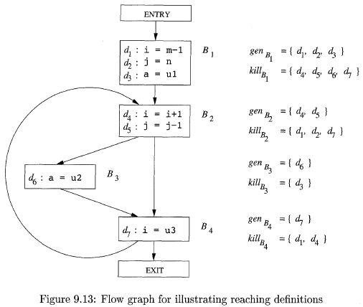
COMPILER DESIGN
Data Flow Analysis
Let us focus on the definitions reaching block B2.
All the definitions in block B1 reach the beginning of block B2.
The definition d₅: j = j-1 in block B2 also reaches the beginning of block B2, because no other definitions of j can be found in the loop leading back to B2.
The definition d₅, however, kills the definition d₂: j = n, preventing it from reaching B3 or B4.

Slide 14
COMPILER DESIGN
Data Flow Analysis
The statement d₄: i = i+1 in B2 does not reach the beginning of B2 though, because the variable i is always redefined by d₇: i = u3.
Finally, the definition d₆ : a = u2 also reaches the beginning of block B2.

Slide 15
𝑑𝑒𝑓_{𝐵}= {variables defined in B prior to any use of that variable in B}
𝑢𝑠𝑒_{𝐵}= {variables used in B prior to definition of that variable in B}
COMPILER DESIGN
Data Flow Analysis
Consider the following cases:
case 2:
B2
case 1:
B1
a = b + c
a = a + 1
a = a + 1
b = b + 1
Basic block
Basic block
𝑑𝑒𝑓_{𝐵1}= {a}
𝑢𝑠𝑒_{𝐵1}= {b, c}
𝑑𝑒𝑓_{𝐵2}= {a, b}
𝑢𝑠𝑒_{𝐵2}= {a, b}

Slide 16
COMPILER DESIGN
Live Variable Analysis
Liveness of a variable
A variable x is live at a point p if there exists a path from p to the exit along which the value of x is used before it is redefined.
Data flow equations are defined in terms of
IN[B]
OUT[B]
Set of variables live at the points immediately before and after the block
Live Variable Analysis is a backward flow problem.

Slide 17
Compiler Design Data-flow values
Live variable Analysis algorithm requires the computation of the following data-flow values -
use[n] : set of variables used by Node n
def [n] : set of variables defined by Node n
in[n] : variables live on entry to Node n
out[n] : variables live on exit from Node n

Slide 18
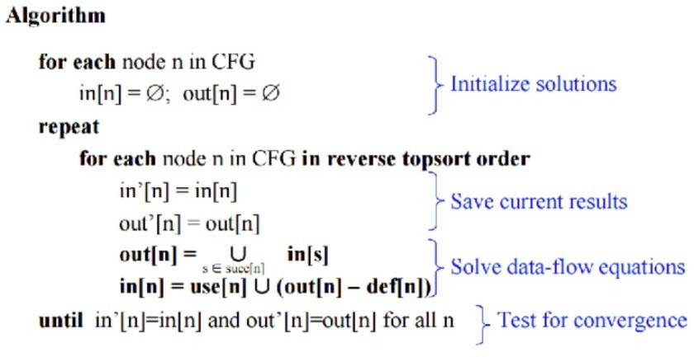
Compiler Design
Live-Variable Analysis Algorithm

Slide 19
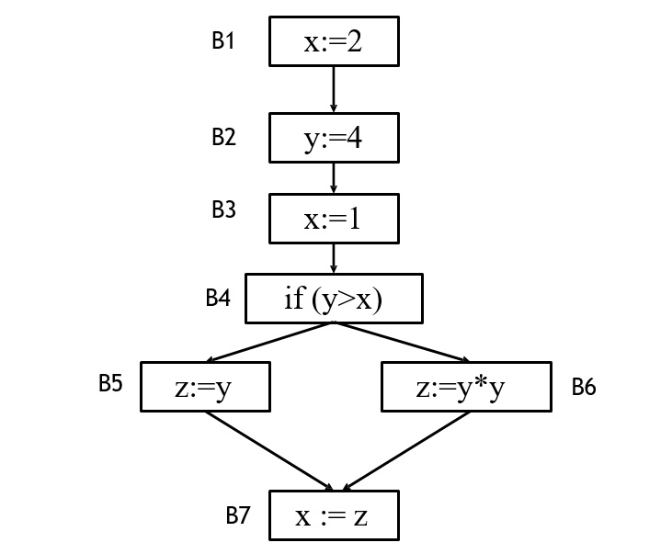
COMPILER DESIGN
Data Flow Analysis: Problem-1
Calculate use[B], def[B], IN[B], OUT[B] by applying Liveness determination algorithm on the following flow graph:

Slide 20
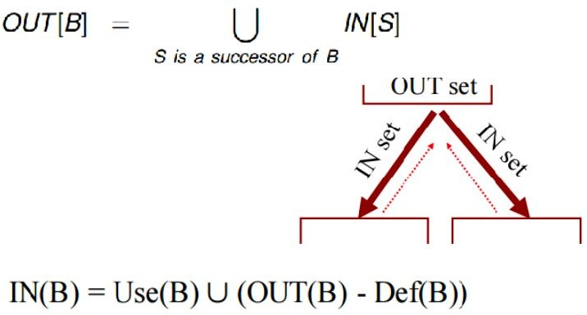
Compiler Design Dataflow equations
Step 3 - Compute IN and OUT for each basic block
OUT [B] = ∪
( IN[S] )
S is a successor of B
IN [B] = use[B] ∪ ( OUT[B] - def[B] )

Slide 21
COMPILER DESIGN
Data Flow Analysis: Problem-1
use[B1] = { Ø }
def[B1] = { x }
B1
x:=2
use[B2] = { Ø }
def[B2] = { y }
y:=4
B2
use[B3] = { Ø }
def[B3] = { x }
B3
x:=1
use[B4] = { y, x }
def[B4] = { Ø }
B4
if (y>x)
use[B3] = { y }
def[B3] = { z }
use[B6] = { y }
def[B6] = { z }
B5
z:=y
z:=y*y
B6
use[B7] = { z }
def[B7] = { x }
B7
x := z

Slide 22
Compiler Design Data-flow equations
The data-flow values are then used to compute IN and OUT sets for each basic block B using the data flow equations-
OUT [B] = ∪ ( IN[S] )
S is a successor of B
IN [B] = use[B] ∪ ( OUT[B] - def[B] )

Slide 23
COMPILER DESIGN
Data Flow Analysis: Problem-1
IN[B1] = { Ø }
B1
x:=2
use[B1] = { Ø }
def[B1] = { x }
IN[B2] = { Ø }
OUT[B2] = { y }
OUT[B1] = { Ø }
use[B2] = { Ø }
def[B2] = { y }
B2
y:=4
IN[B3] = { y }
B3
x:=1
use[B3] = { Ø }
def[B3] = { x }
IN[B4] = { x, y }
use[B4] = { y, x }
def[B4] = { Ø }
OUT[B3] = { x, y}
B4
if (y>x)
IN[B6] = { y }
OUT[B4] = { y }
use[B6] = { y }
def[B6] = { z }
B5
z:=y
z:=y*y
B6
IN[B5] = { y }
use[B5] = { y }
def[B5] = { z }
OUT[B6] = { z }
IN[B7] = { z }
use[B7] = { z }
def[B7] = { x }
OUT[B5] = { z }
x := z
B7
OUT[B7] = { Ø }

Slide 24
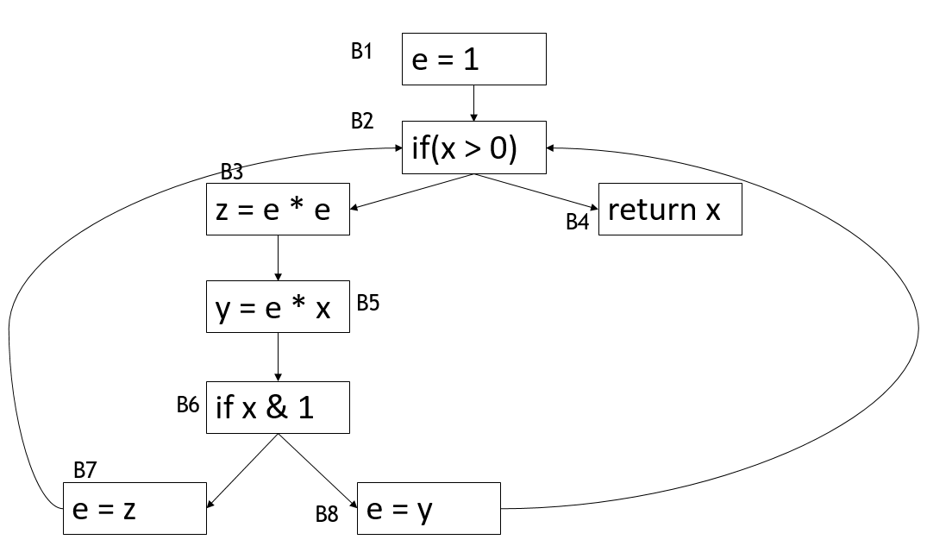
COMPILER DESIGN
Data Flow Analysis: Problem-2
Calculate use[B], def[B], IN[B], OUT[B] by applying Liveness determination algorithm on the following flow graph:

Slide 25
COMPILER DESIGN
Data Flow Analysis: Problem-2
use[B1] = { Ø }
def[B1] = { e }
e = 1
B1
B2
use [B2] = { x }
def[B2] = {Ø }
if(x > 0)
B3
use[B3] = { e }
def[B3] = { z }
z = e * e
return x
use [B4] = { x }
def[B4] = { Ø }
B4
use [B5] = { e, x }
def[B5] = { y }
y = e * x
B5
use[B6] = { x }
def[B6] = { Ø }
B6
if x & 1
B7
use[B7] = { z }
def[B7] = { e }
e = z
e = y
use[B8] = { y }
def[B8] = { e }
B8

Slide 26
COMPILER DESIGN
Data Flow Analysis: Problem-2
1st iteration
IN[B1] = { x }
B1
e = 1
use[B1] = { Ø }
def[B1] = { e }
IN[B3] = { e, x}
IN[B2] = { e, x }
use[B3] = { e }
def[B3] = { z }
B2
use [B2] = { x }
def[B2] = {Ø }
OUT[B1] = { e, x }
if(x > 0)
B3
OUT[B3] = { e, z, x }
OUT[B2] = { e, x }
z = e * e
return x
B4
IN[B5] = { e, x, z }
IN[B4] = { x }
use [B5] = { e, x }
def[B5] = { y }
use [B4] = { x }
def[B4] = { Ø }
y = e * x
B5
IN[B6] = { x, y, z }
OUT[B5] = { x, y, z }
OUT[B4] = { Ø }
use[B6] = { x }
def[B6] = { Ø }
B6
if x & 1
IN[B7] = { z }
OUT[B6] = { y, z }
IN[B8] = { y }
use[B7] = { z }
def[B7] = { e }
B7
use[B8] = { y }
def[B8] = { e }
e = z
e = y
OUT[B7] = { Ø }
B8
OUT[B8] = { Ø }

Slide 27
COMPILER DESIGN
Data Flow Analysis: Problem-2
2nd iteration
IN[B1] = { x }
B1
e = 1
use[B1] = { Ø }
def[B1] = { e }
IN[B2] = { e, x }
IN[B3] = { e, x }
use [B2] = { x }
def[B2] = {Ø}
B2
OUT[B1] = { e, x }
use[B3] = { e }
def[B3] = { z }
if(x > 0)
B3
OUT[B2] = { e, x}
z = e * e
return x
OUT[B3] = { e, x, z }
B4
IN[B4] = { x }
IN[B5] = { e, x, z }
use [B4] = { x }
def[B4] = { Ø }
use [B5] = { e, x }
def[B5] = { y }
y = e * x
B5
OUT[B4] = { Ø }
OUT[B5] = { x, y, z }
IN[B6] = { x, y, z }
use[B6] = { x }
def[B6] = { Ø }
B6
if x & 1
IN[B7] = { x, z }
IN[B8] = { x, y}
use[B7] = { z }
def[B7] = { e }
OUT[B6] = { x, y, z }
B7
use[B8] = { y }
def[B8] = { e }
e = z
e = y
OUT[B7] = { e, x}
B8
OUT[B8] = { e, x}

Slide 28
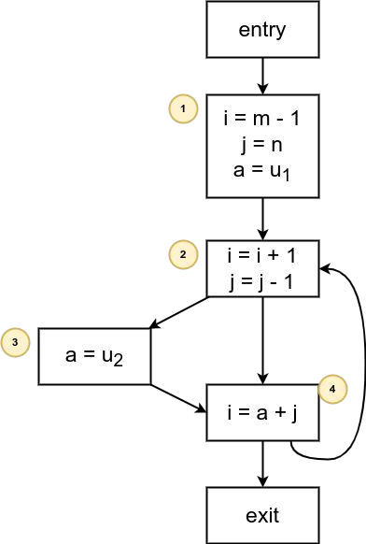
Compiler Design Example 2
Compute Liveness Information for the following CFG -

Slide 29
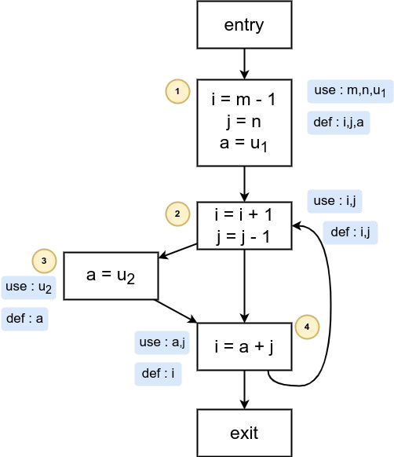
Compiler Design Example 2 - Solution
Step 2 - Compute use and def for each basic block.

Slide 30
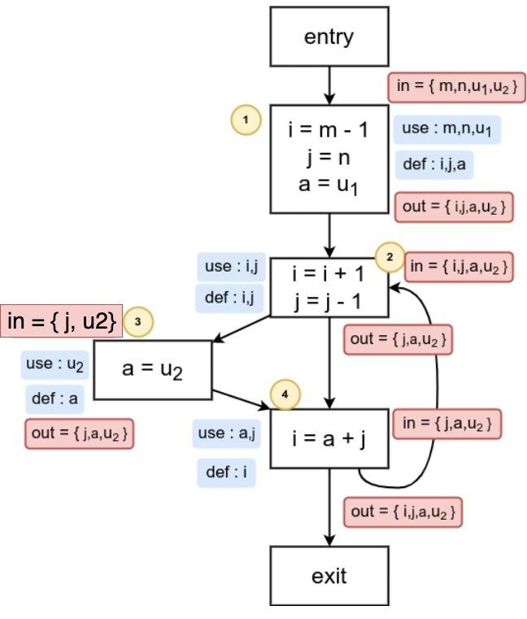
Compiler Design Example 2 - Solution
Step 3 - Compute IN and OUT for each basic block

Slide 31
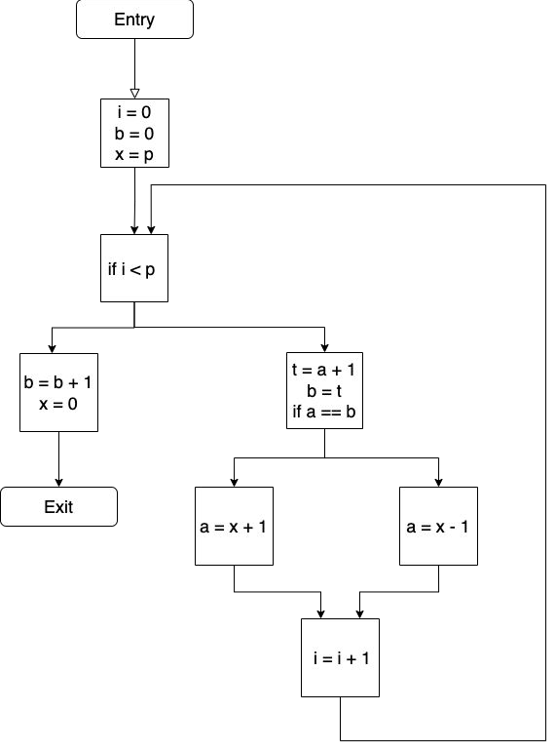
Compiler Design Example 3
Compute Liveness Information for the following CFG -

Slide 32
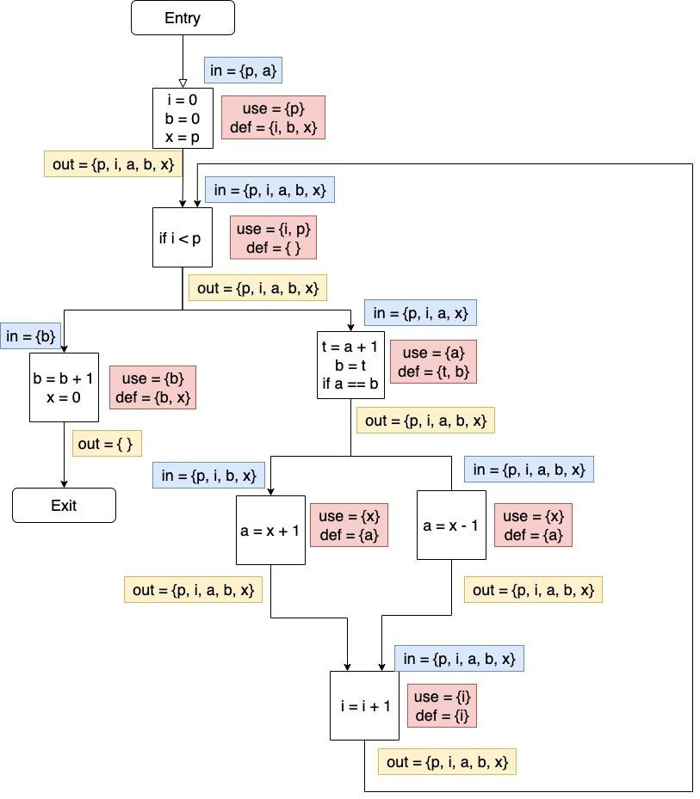
Compiler Design Example 3 - Solution

Slide 33
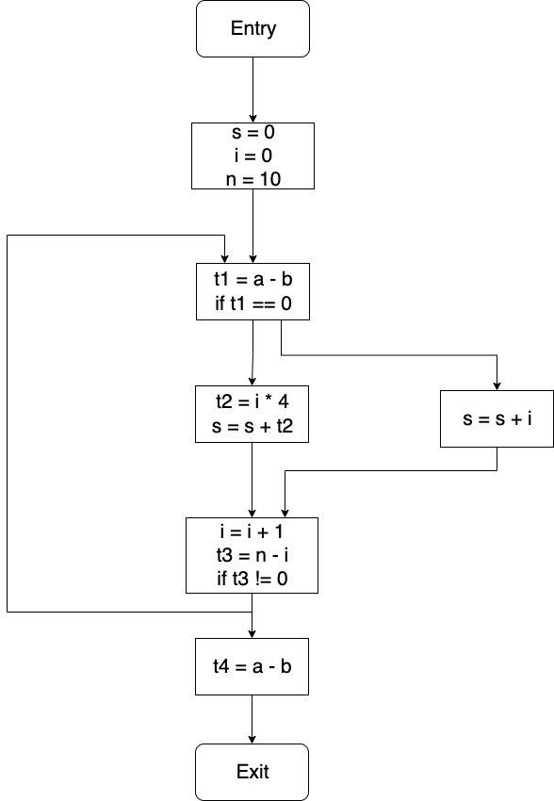
Compiler Design Example 4
Compute Liveness Information for the following CFG -

Slide 34
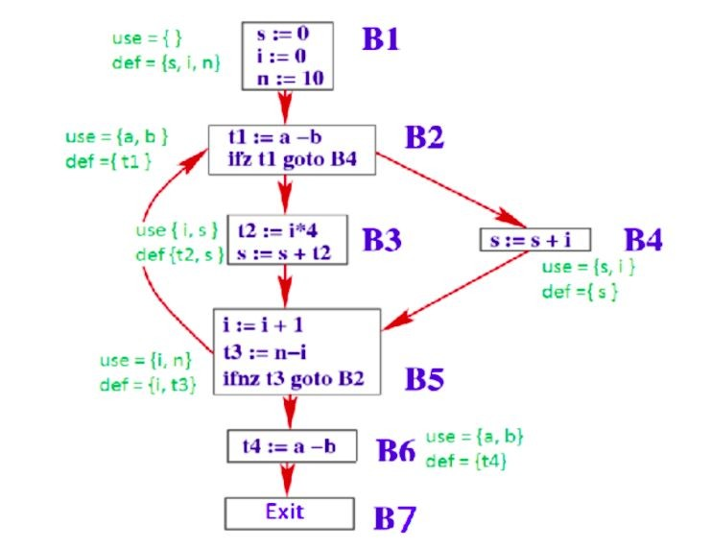
Compiler Design Example 4 - Solution

Slide 35
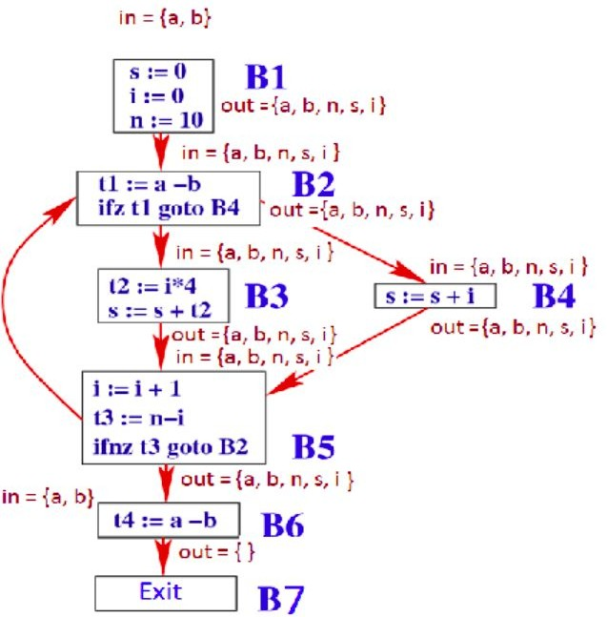
Compiler Design Example 4 - Solution

Slide 36
Compiler Design Example 5
Compute Liveness Information for the following CFG -

Slide 37
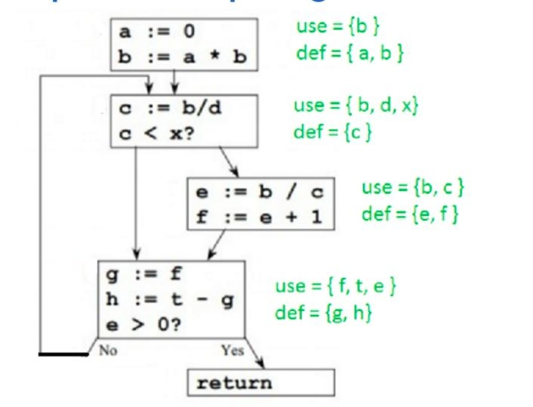
Compiler Design Example 2 - Solution
Step 2 - Compute use and def for each basic block.

Slide 38
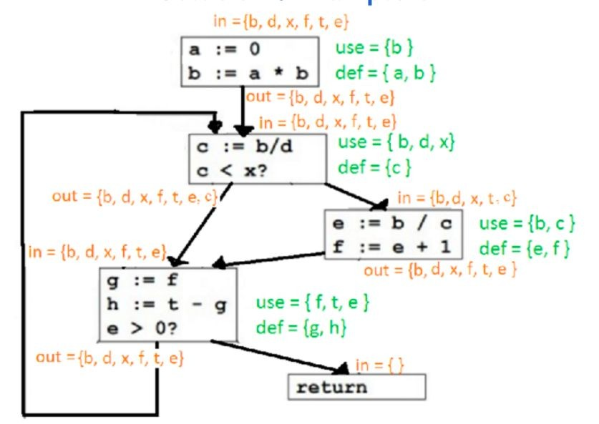
Compiler Design Example 2 - Solution

Slide 39
Compiler Design Applications or advantages of live variable analysis
Register Allocation - If a variable is dead at a given point p, we can reuse its storage, i.e, the register it occupies (if any).
Dead code elimination - If variable x is not live after an assignment x = …, then the assignment is redundant and can be deleted as dead code.

Slide 40
THANK YOU
Preet Kanwal
Department of Computer Science & Engineering
preetkanwal@pes.edu

